Slide 1

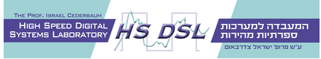

Parking system – LED screen controller
Amir Daichik
Golan Robinsohn
Supervisor Oz Shmueli

Slide 2
Motivation
To shorten parking search times and to decrease heavy traffic in the parking lot.
Adding the ability to manipulate parking space availability.
Creating a generic screen LED controller that enable scalability in terms of the size of the screen , the types of drawings it supports and the interfaces it supports.
Notes:
- הפלאפונים סובבים אותנו. לכל אחד יש ולמה לא לנצל את זה לטובת איסוף מידע?
Personal cellphones have become an integral part of our lives
Many Applications, such as “waze”, are using that to create a large and effective database
Our concept is based on this principle while using many inner sensors onboard our cellphones, at any given time (such as temperature, gyro, magnetic field etc.)
the goal is to make an interactive map which shows processed sensors information acquired from cellphones that use the application

Slide 3
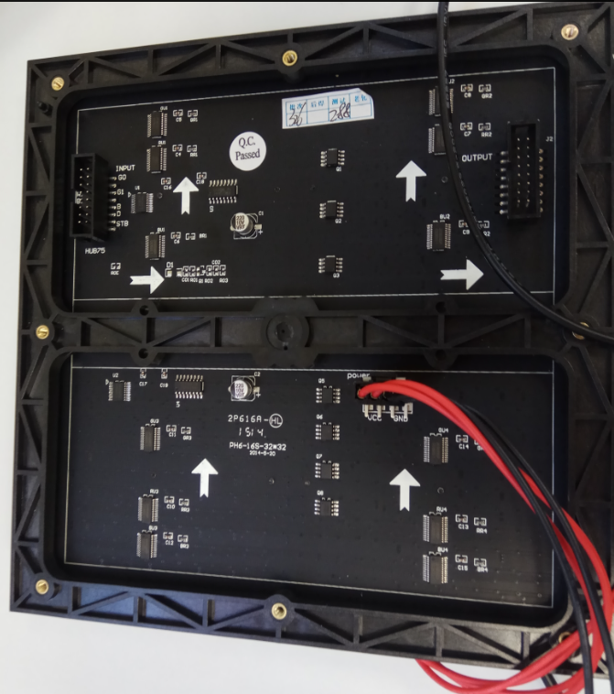
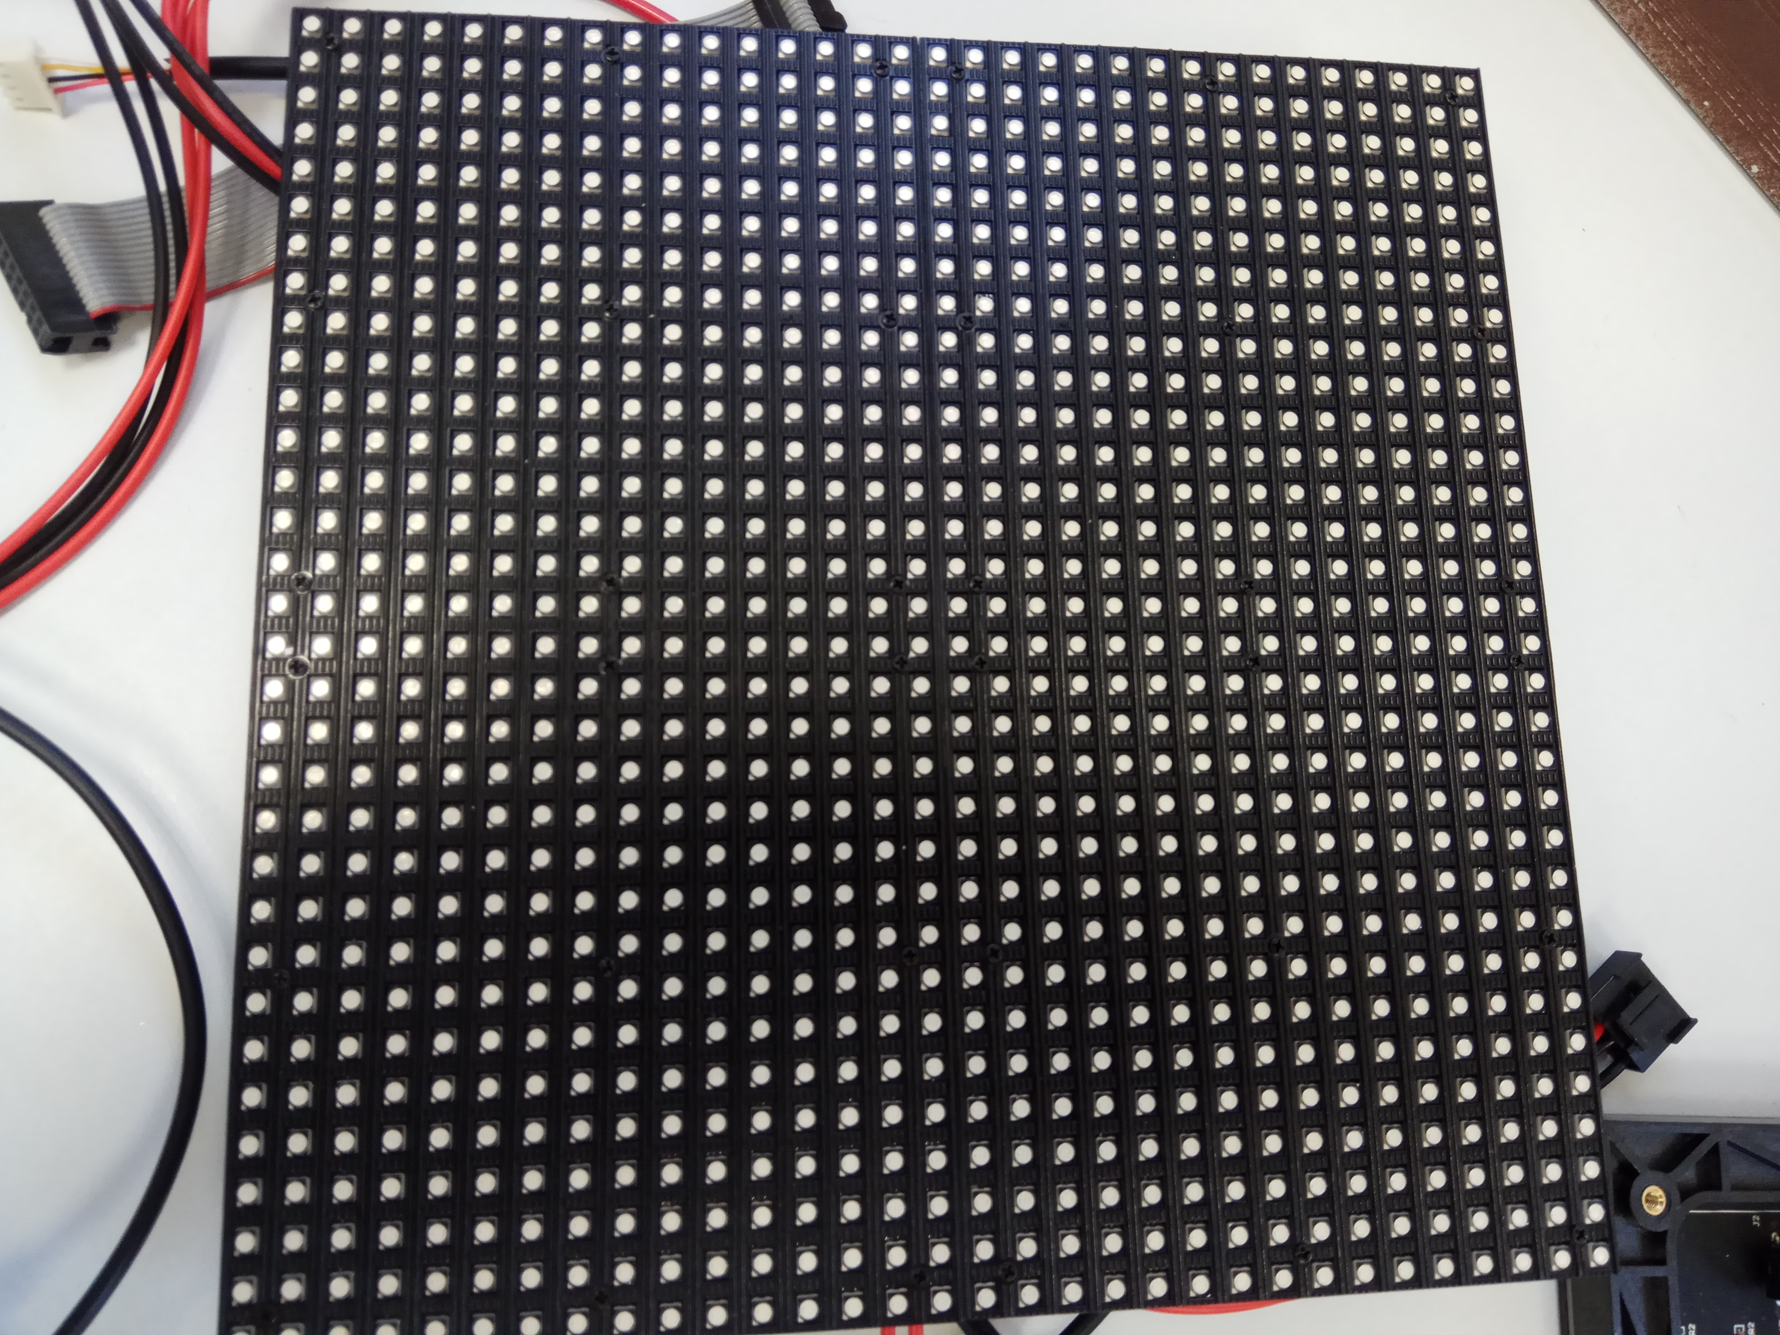
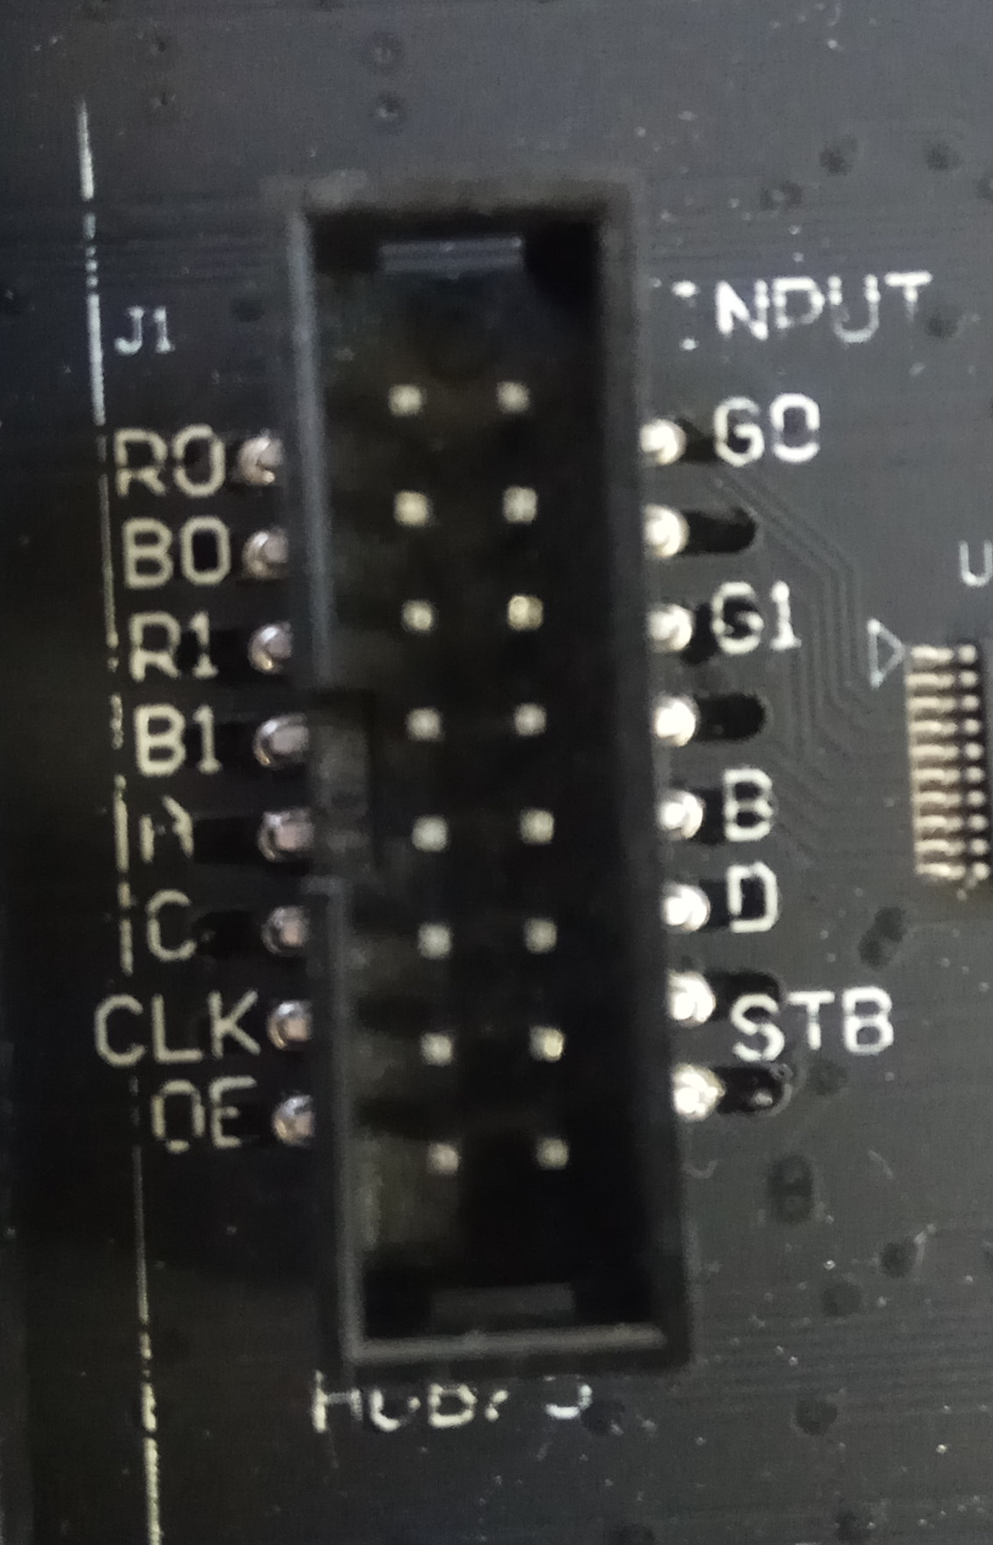
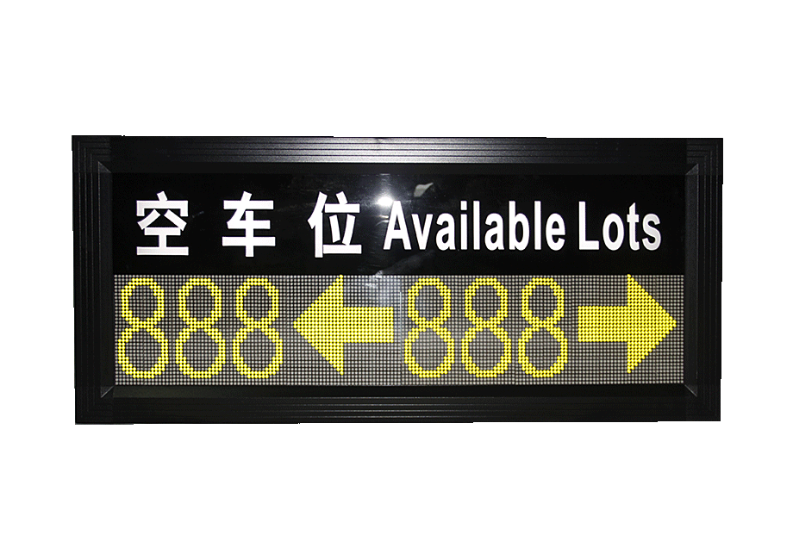
Project Components LEDs block for building custom size screen
Back
Front
LED connector
Fixed size screen

Slide 4
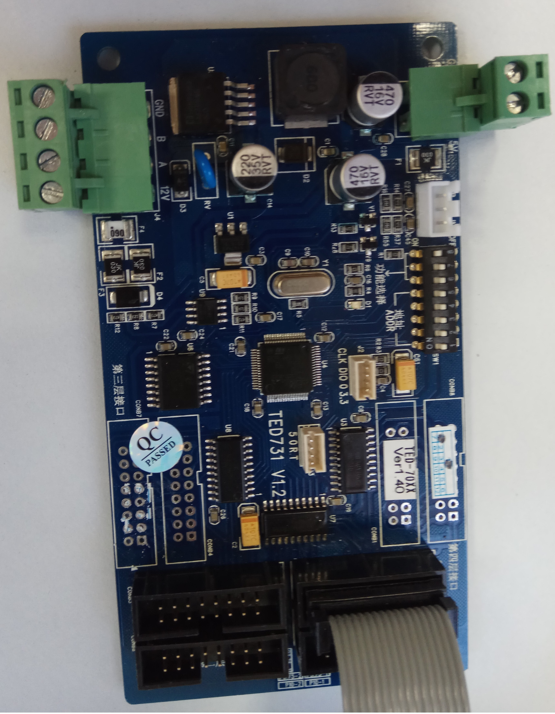
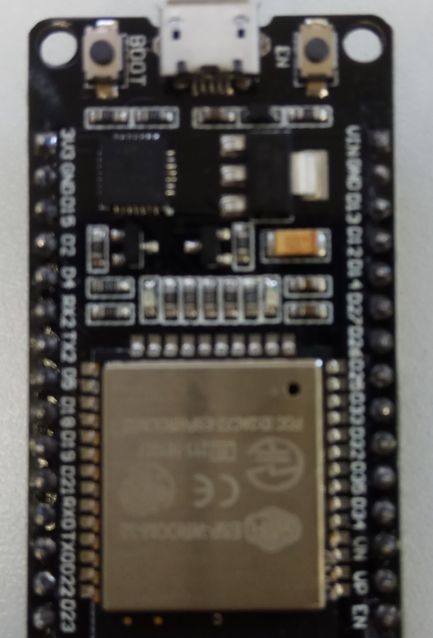
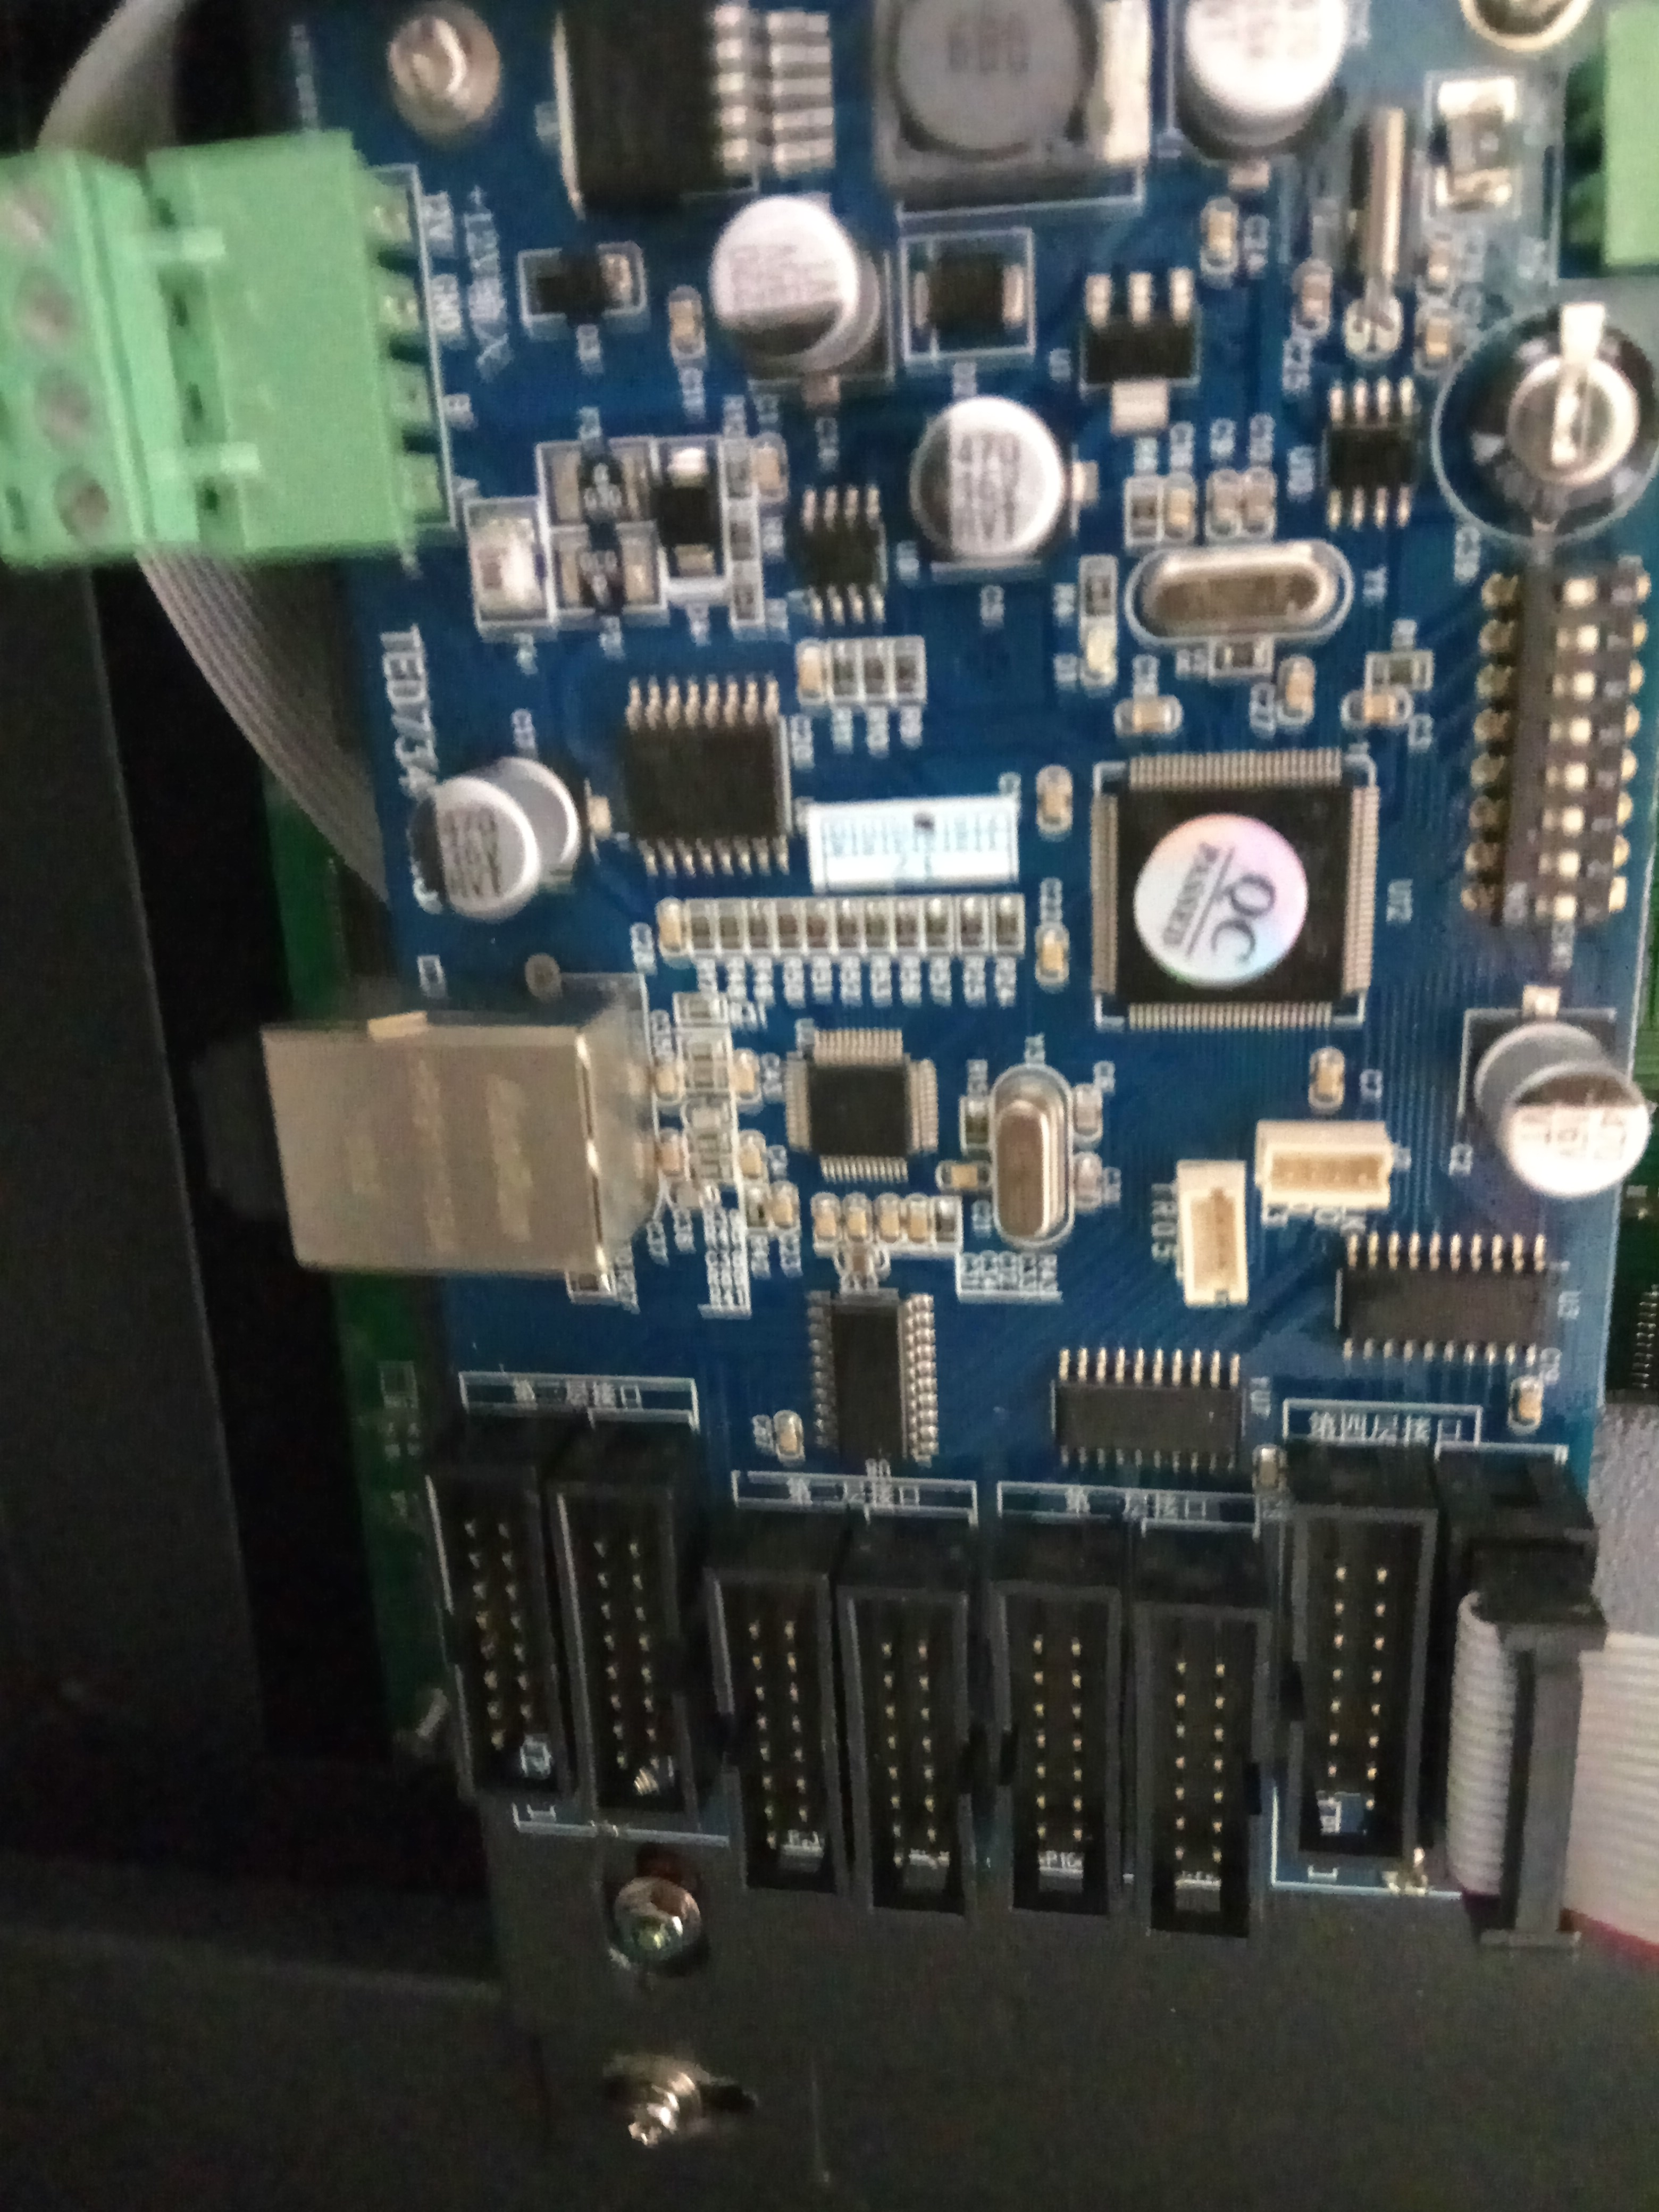
Project Components LED screen controllers
Bus 485 controller
ESP controller
Eth controller

Slide 5

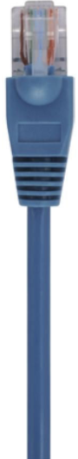
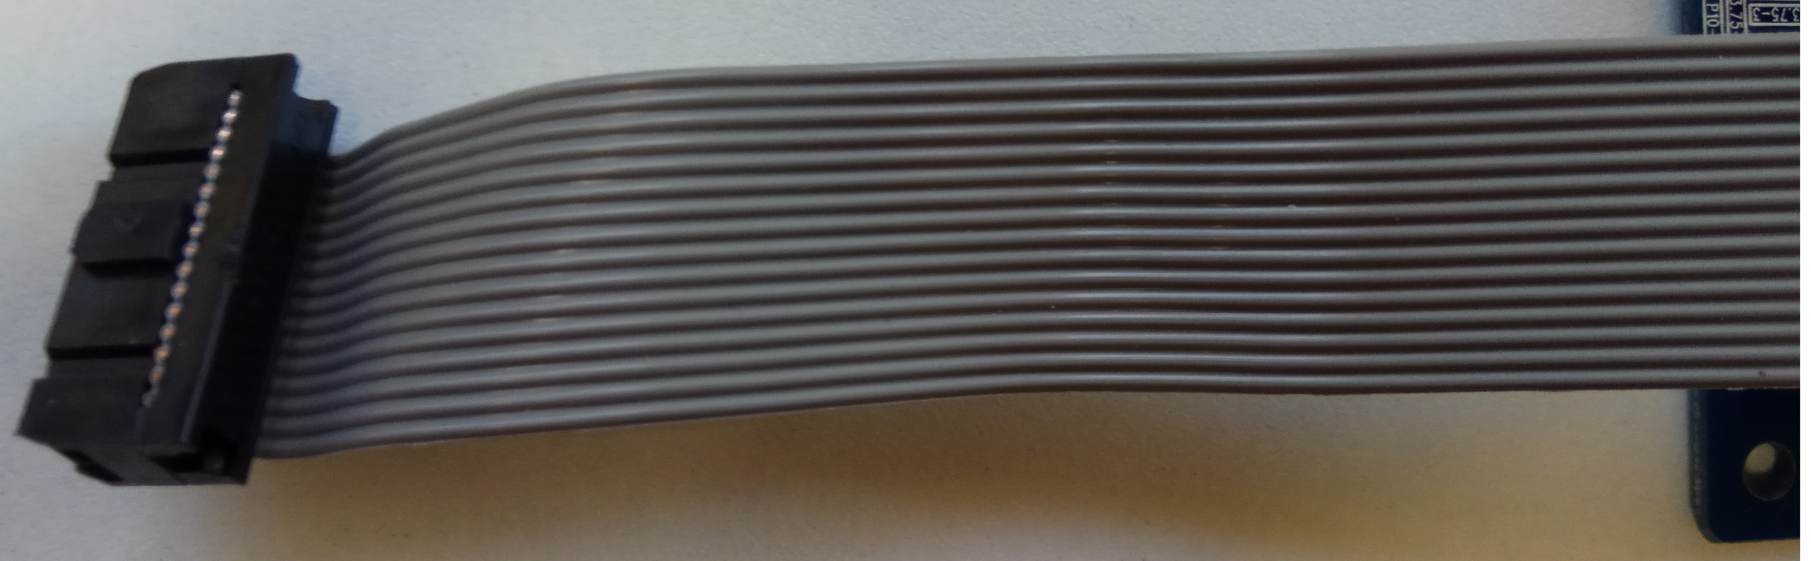
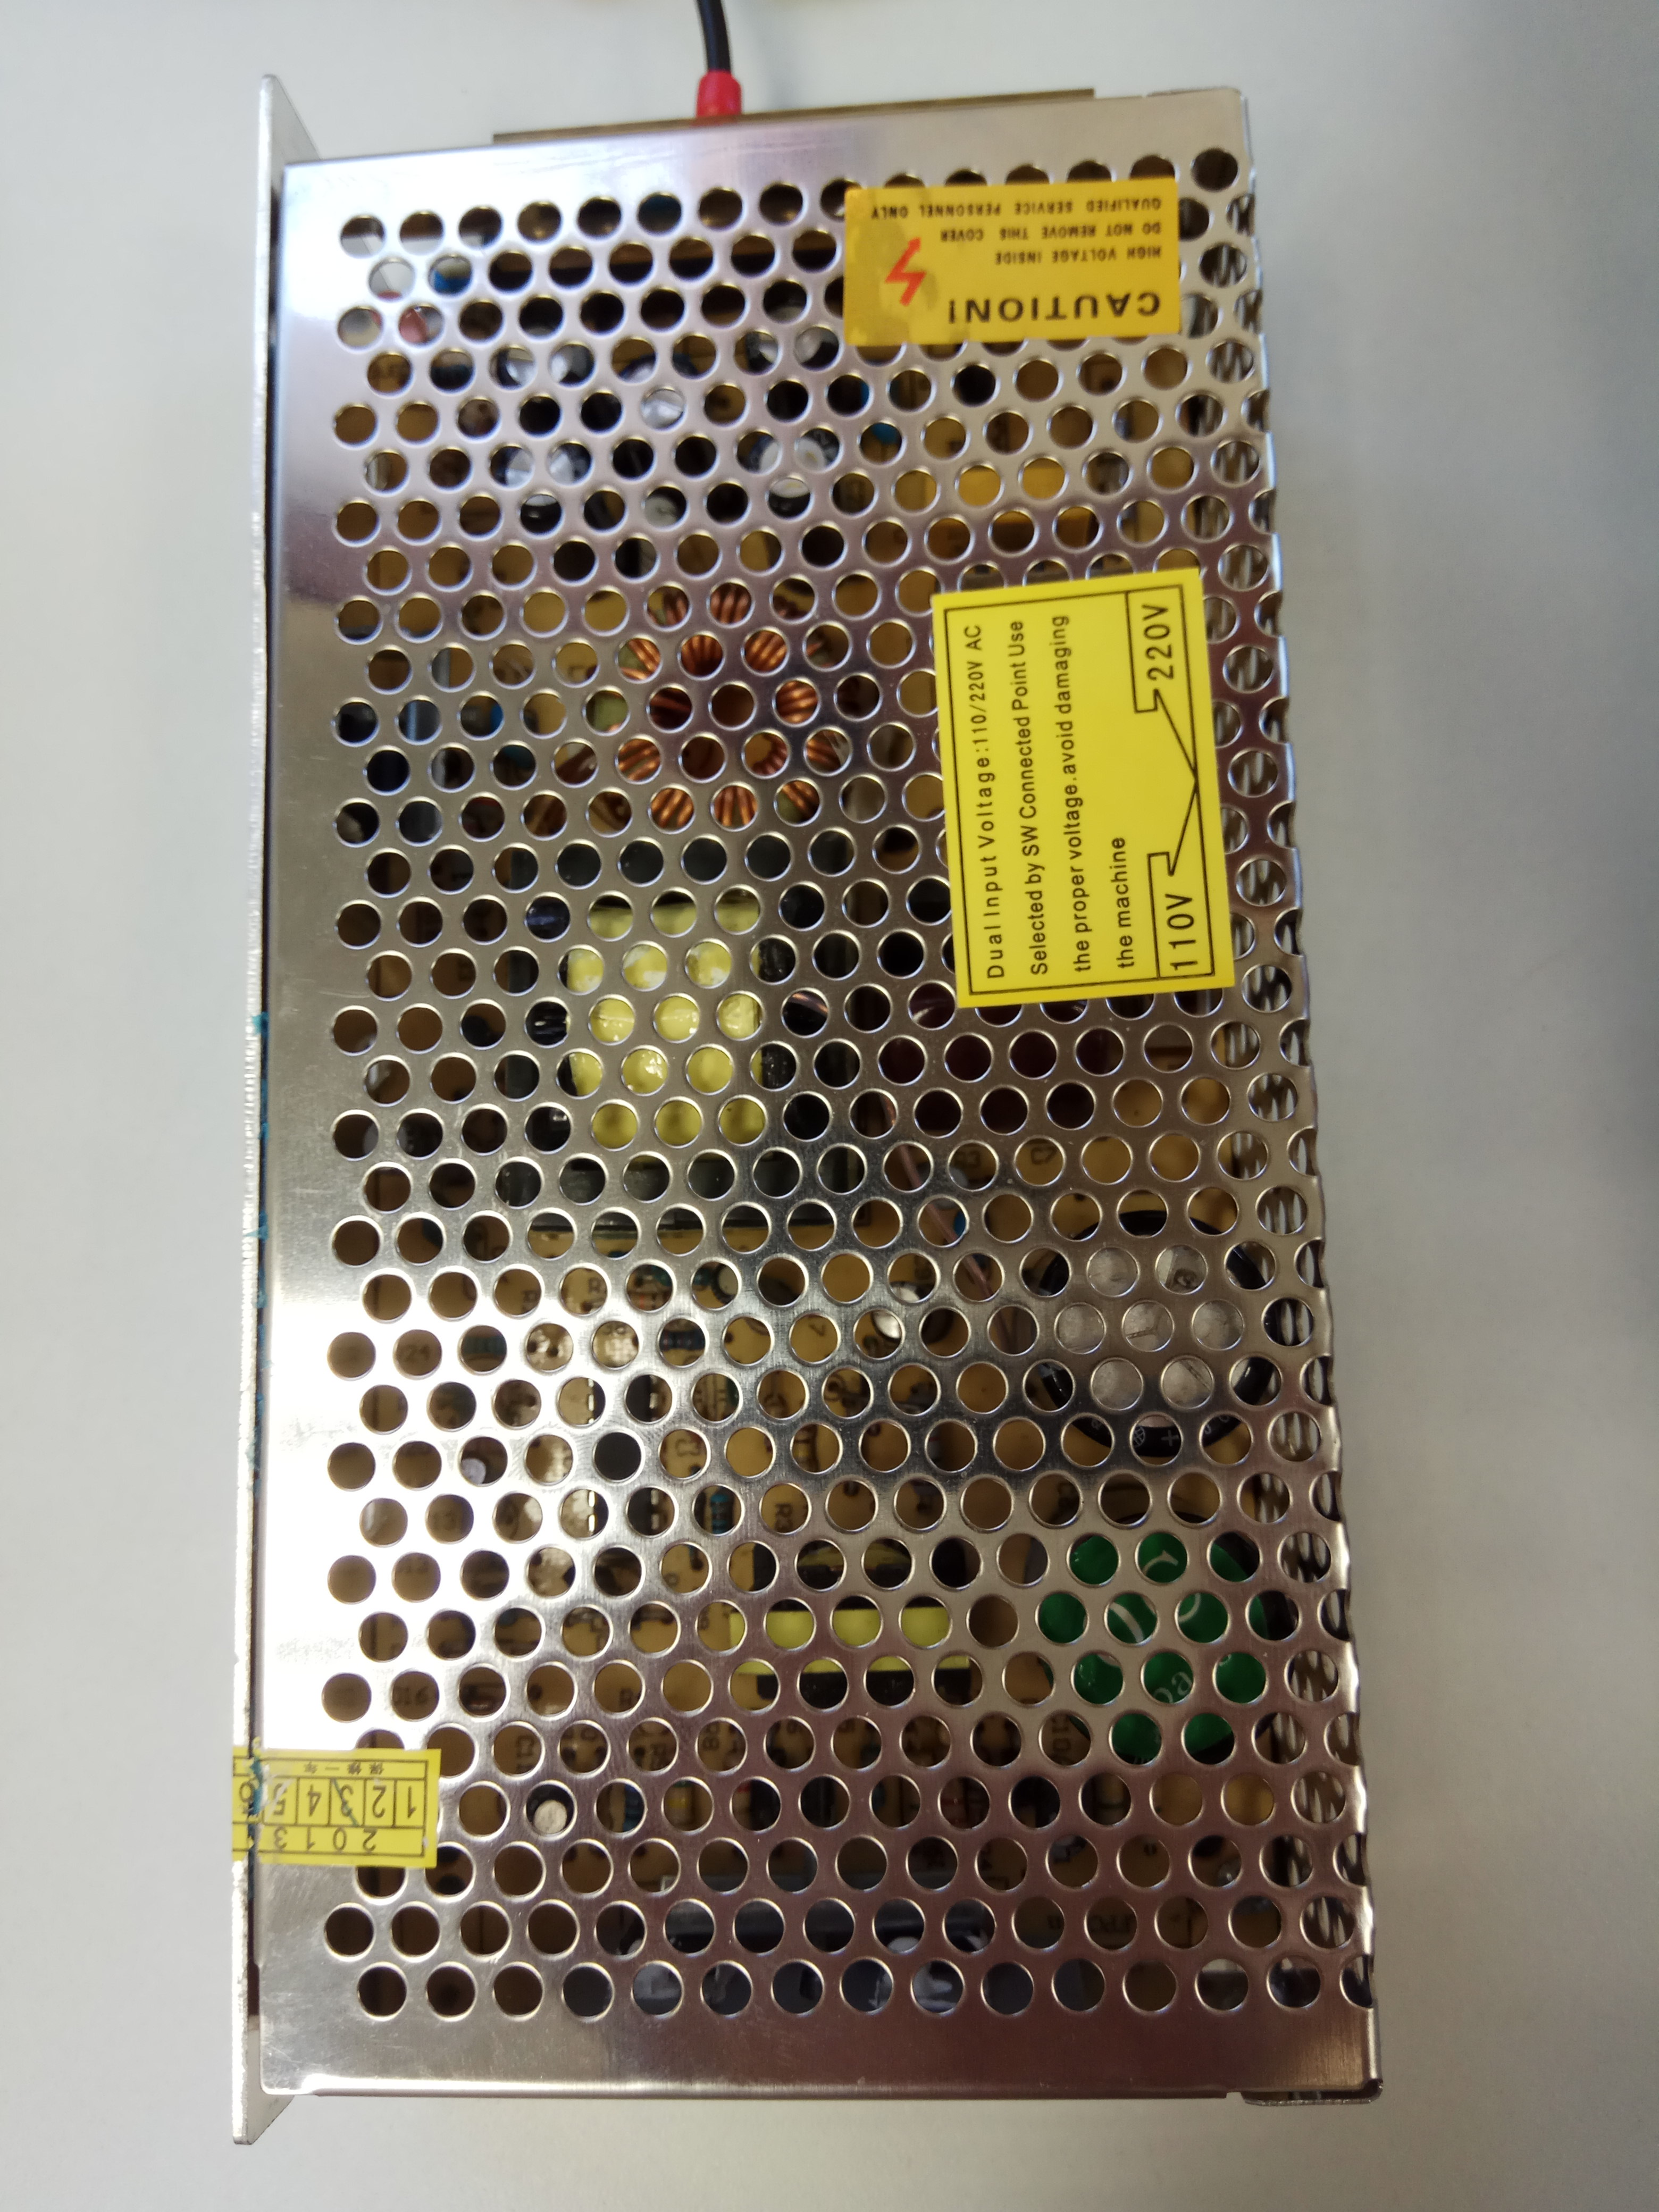
Initial connectivity
Computer adapter
uArt 323 - Bus 485
Power supply

Slide 6
Final connectivity goal
Internet
WIFI
. . .
. . .
GPIO
. . .

Slide 7
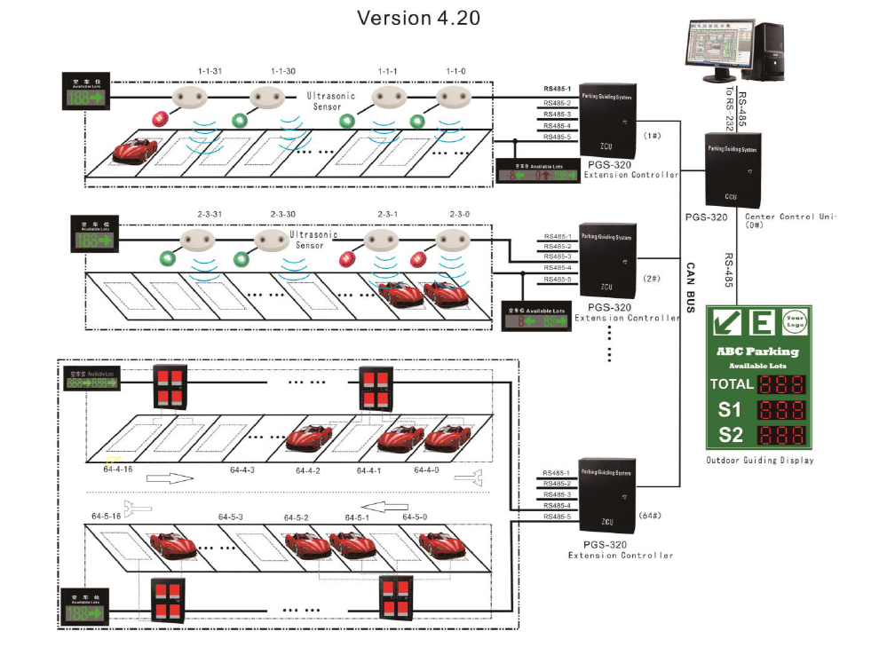
System Overview

Slide 8
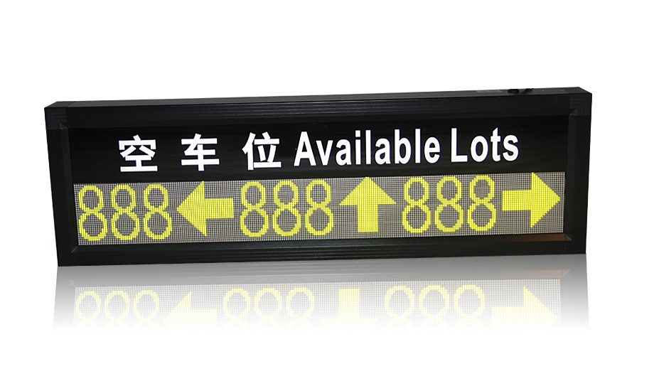
Project Goals
To operate a LEDs screen with all the different controllers (Eth controller, BUS 485 and ESP controller)
To build a controller that supports all the commands that the controllers from the factory supports.
To define and implement user interface which gives flexibility for the usage of the controller.
Different interfaces.
Different drawings.
Different screen connectivities.
Notes:
interactive map
Developing an android app which samples the data from the onboard sensors, and transmits them to a cloud server
Storing the data on a cloud server and processing it on a local server
Creating an online map that present this database, for computer browsers and mobile users who own the app

Slide 9
Controller main features
Support all the excising commands of the original controllers.
Support different LED screen configurations (In parallel , serial with direction ..)
Support the ability to add new drawings.
Support different colors.
Notes:
כשאין קליטת GPS - לא דוגמים

Slide 10
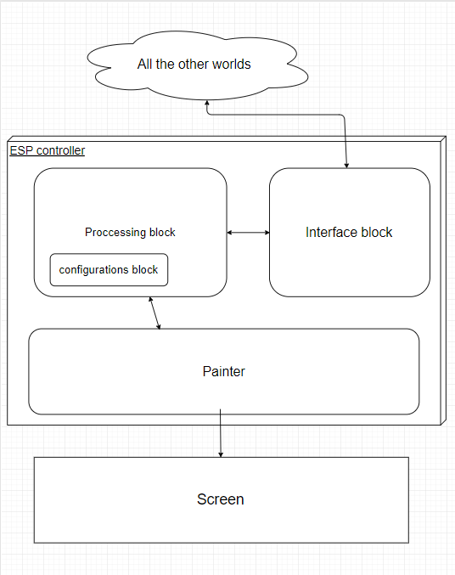
Initial programming block diagram of the ESP controller
Interface block will receive and send data from the world to the ESP controller (it will support GPIO and wifi protocol)
Processing block will receive commands from the input interface and will process the commands and either send responses to the output interface or send commands to the painter.
Painter will receive a matrix from the processing block and will paint the matrix on the screen.

Slide 11
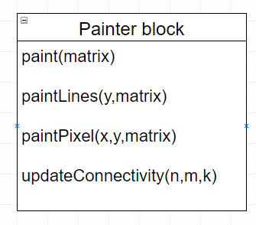
Initial programming block diagram of the ESP controller
Paint(matrix) will paint the requested matrix on the screen
paintLines(y,matrix) will be in charge of panting the y’th row. (It will draw K lines in parallel)
paintPixels(x,y,matrix) will be in charge of painting (x,y) pixel . It will draw K pixels in parallel.
updateConnectivity will update the painter about the topology of the LEDs screen.

Slide 12
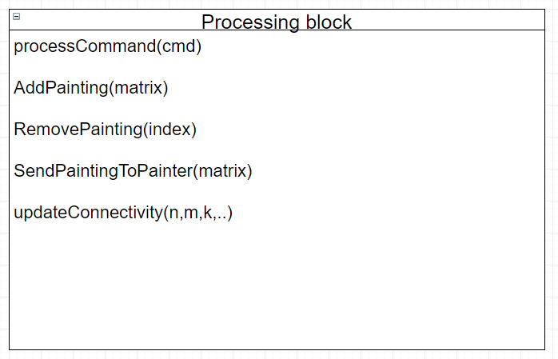
Initial programming block diagram of the ESP controller
processCommand will receive commands from the input interface , will parse it and will be in charge of execution.
AddPainting will add a new painting to the database. We will be able to draw later via drawing command (We will need to return the user an index as a response to this command)
RemovePainting will remove a painting from the database.
SendPaintingToPainter will send a matrix which contains data for the painter block
updateConnectivity will be in charge of updating the topology of the LEDs screen. We assume that the parallel connections are symmetric. We will need to support directional connectivity. There will be K parallel connections

Slide 13
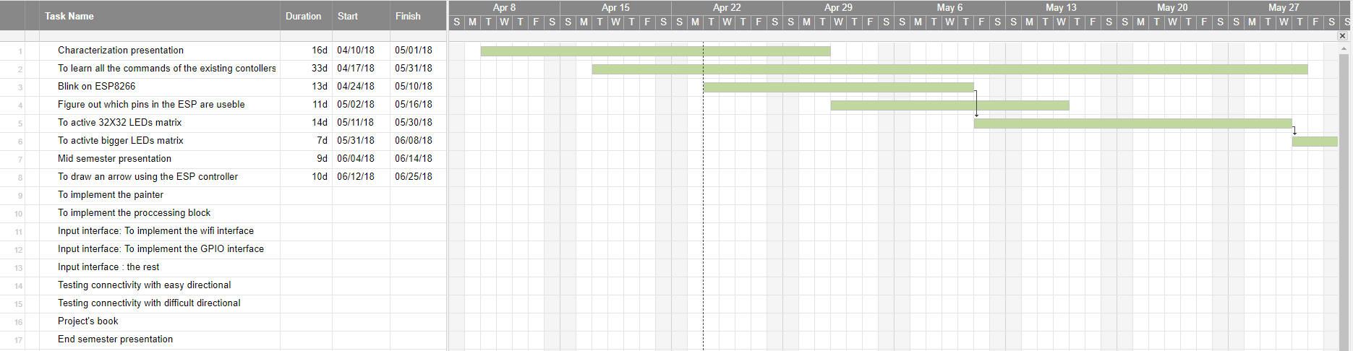
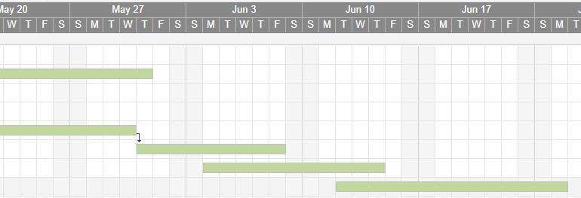
Estimated initial Gantt

